Slide 1
Mean Shift (Unsupervised Learning)

Slide 2
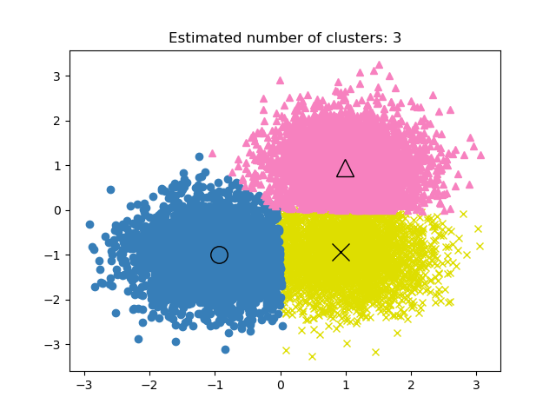
1.MeanShift clustering aims to discover blobs in a smooth density of samples. 2. It is a centroid based algorithm, which works by updating candidates for centroids to be the mean of the points within a given region. 3.These candidates are then filtered in a post-processing stage to eliminate near-duplicates to form the final set of centroids.

Slide 3
The algorithm automatically sets the number of clusters, instead of relying on a parameter bandwidth,
which dictates the size of the region to search through.
This parameter can be set manually, but can be estimated using the provided estimate_bandwidth function,
which is called if the bandwidth is not set.
The algorithm is not highly scalable, as it requires multiple nearest neighbor searches during the
execution of the algorithm.
The algorithm is guaranteed to converge, however the algorithm will stop iterating when the change in centroids is small.
Labelling a new sample is performed by finding the nearest centroid for a given sample.

Slide 4
The algorithm automatically sets the number of clusters, instead of relying on a parameter bandwidth,
which dictates the size of the region to search through.
This parameter can be set manually, but can be estimated using the provided estimate_bandwidth function,
which is called if the bandwidth is not set.
The algorithm is not highly scalable, as it requires multiple nearest neighbor searches during the execution of the algorithm.
The algorithm is guaranteed to converge, however the algorithm will stop iterating when the change in centroids is small.
The position of centroid candidates is iteratively adjusted using a technique called hill climbing, which finds local maxima of the estimated probability density. Given a candidate centroid x for iteration t.

